Slide 1
LANGUAGE HUB TEACHER’S APP

Slide 2
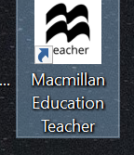
The Teacher App

Slide 3
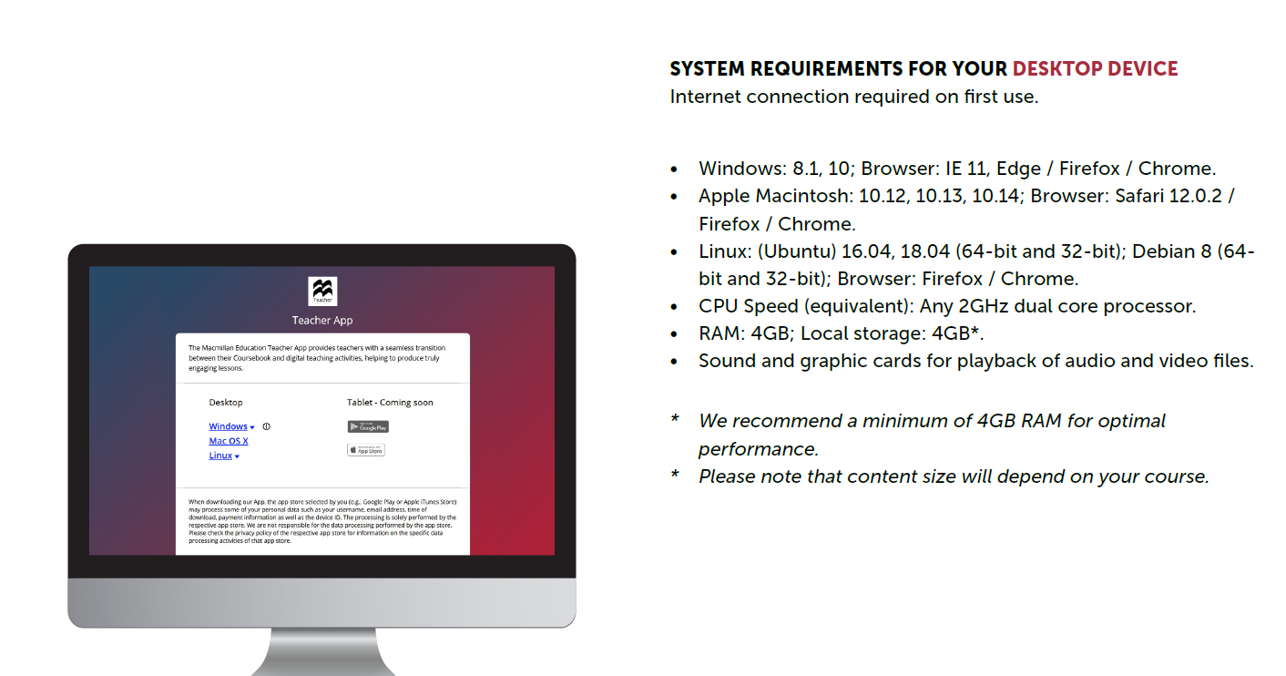
The Teacher App

Slide 4
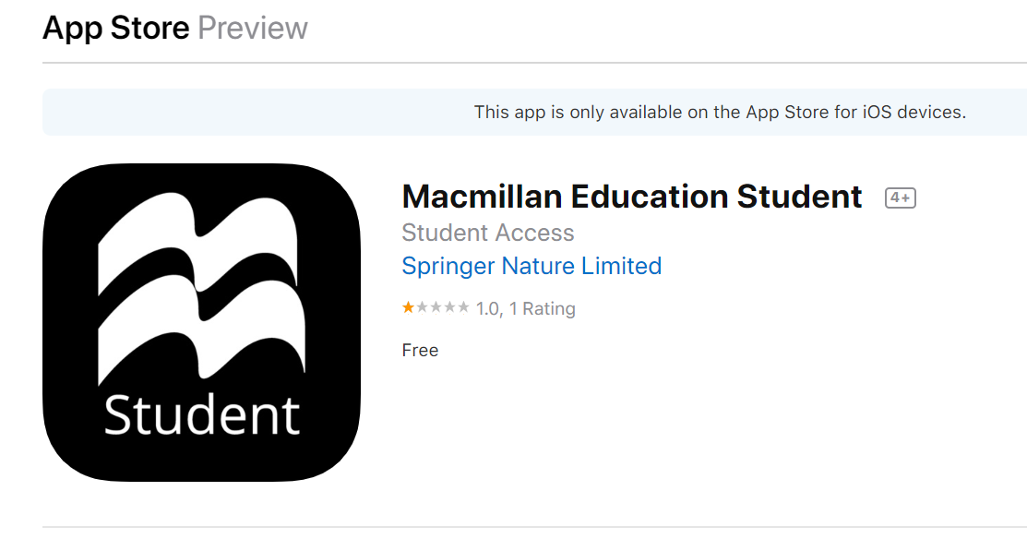
The Student App

Slide 5
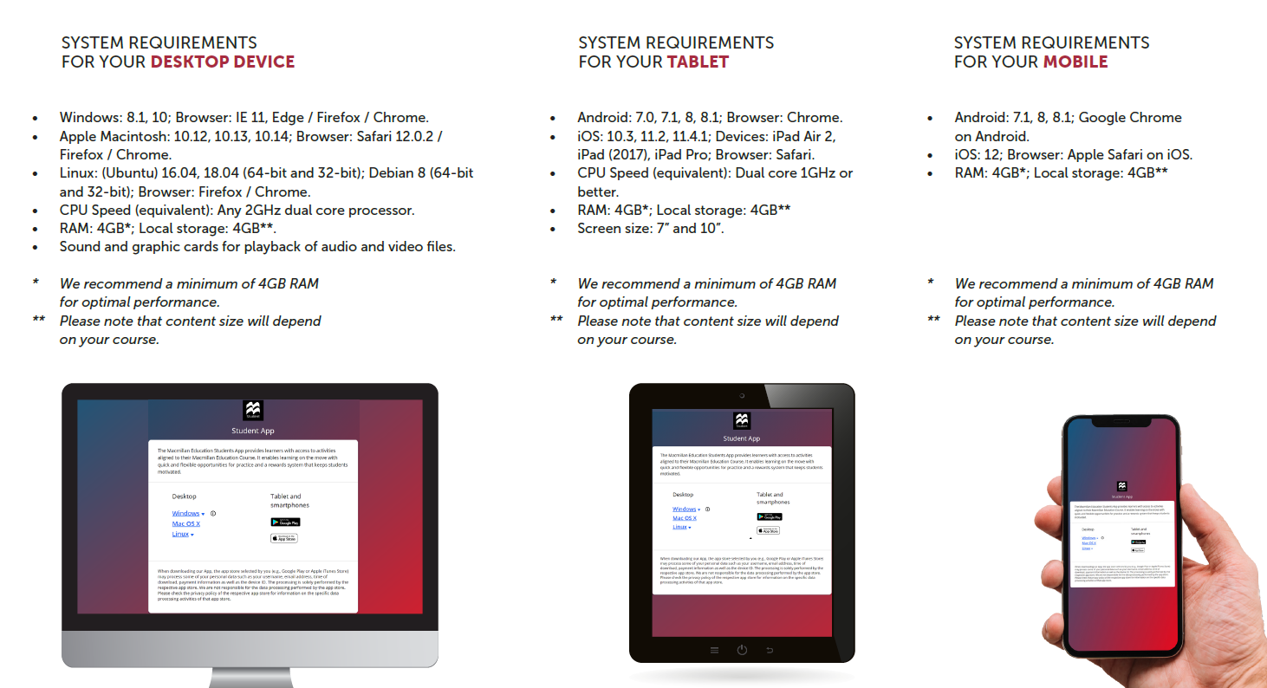
The Student App

Slide 6
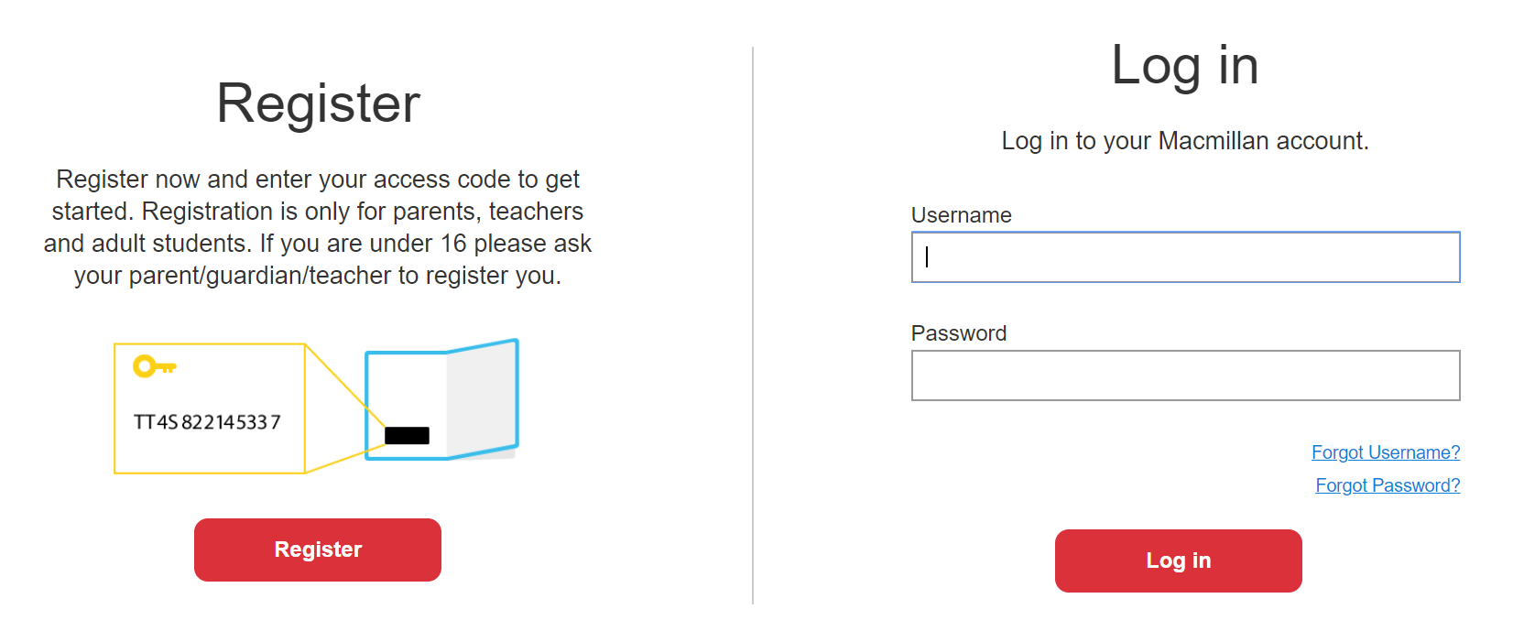
Please go to www.macmillaneducationeverywhere.com website, enter your account information and click on Log In

Slide 7
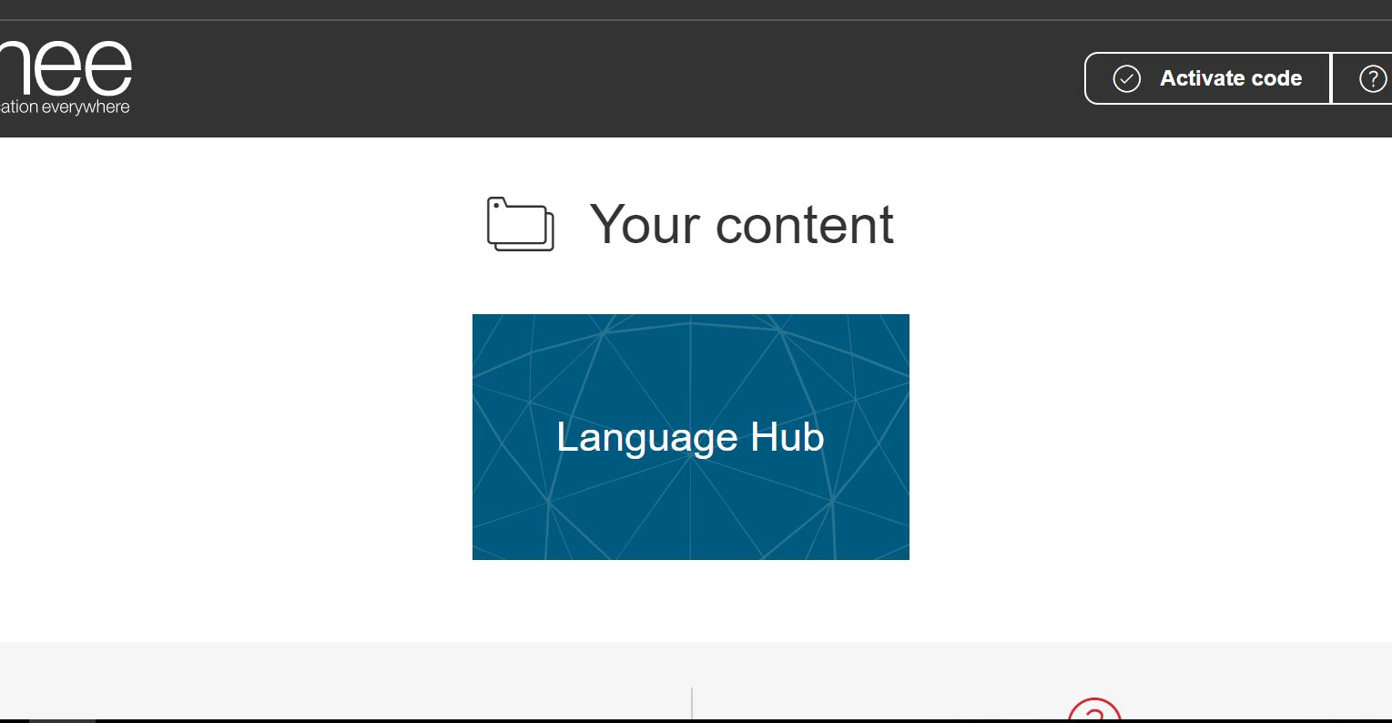
2. Click on the Language Hub box

Slide 8
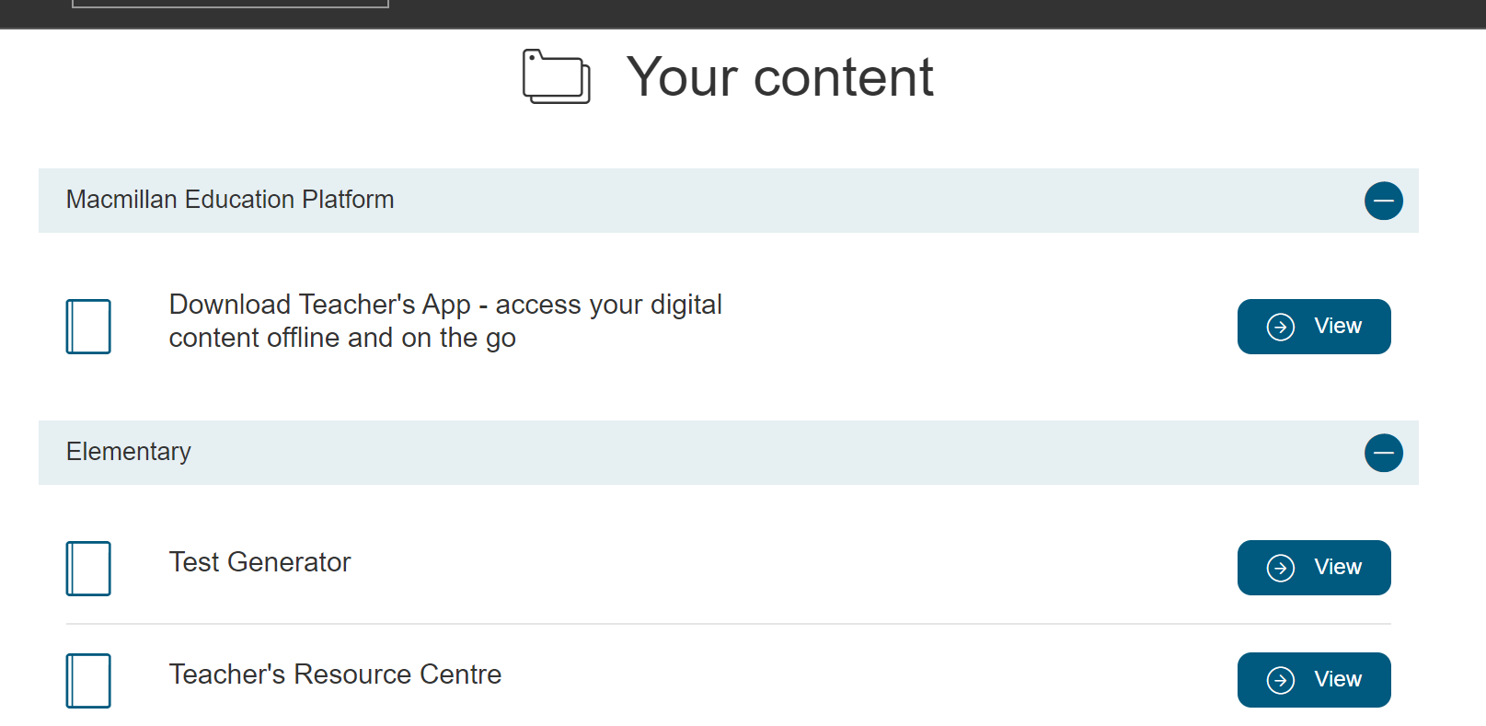
3. To download the Teacher’s App click on View

Slide 9
4. To access Test Generator or TRC click on View button as well

Slide 10
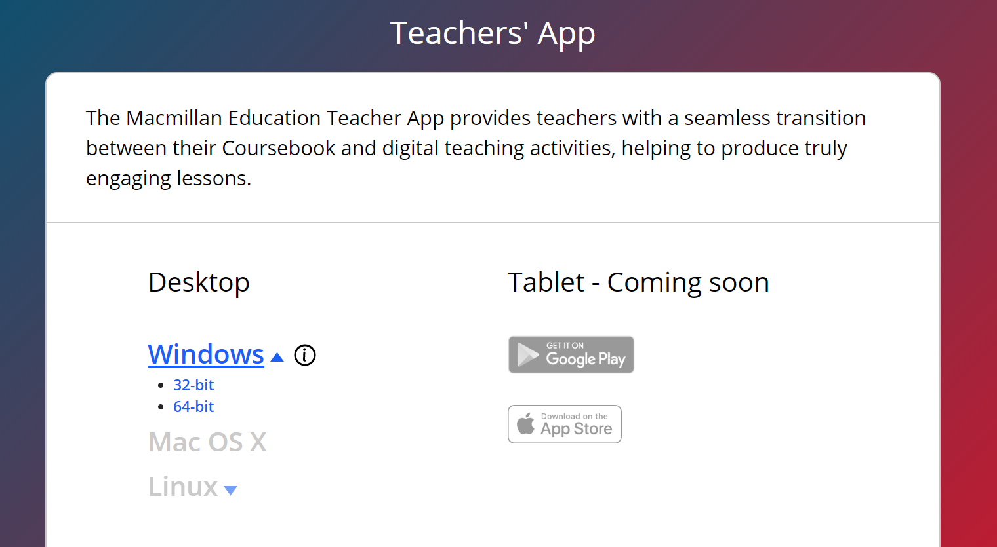
5. Depending on your Windows configuration click on one of the options: 32bit or 64 bit

Slide 11
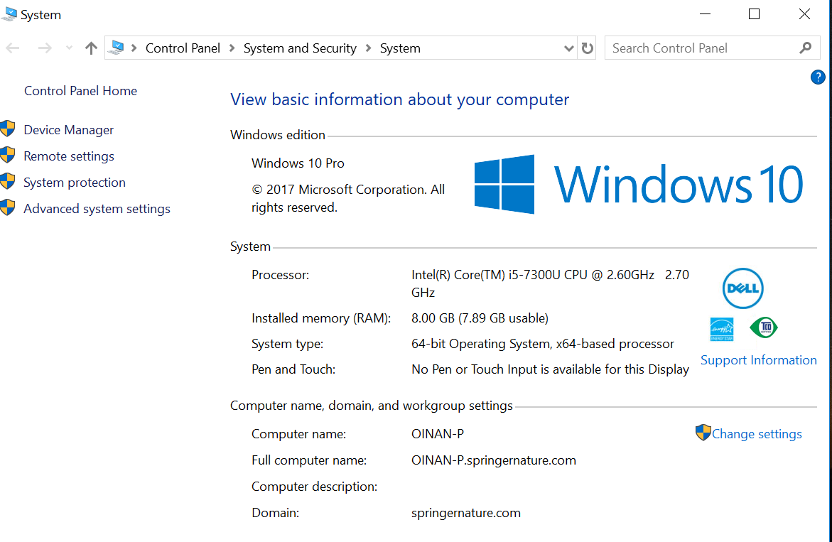
6. If you do not know your system configuration, go to your computer’s properties section

Slide 12
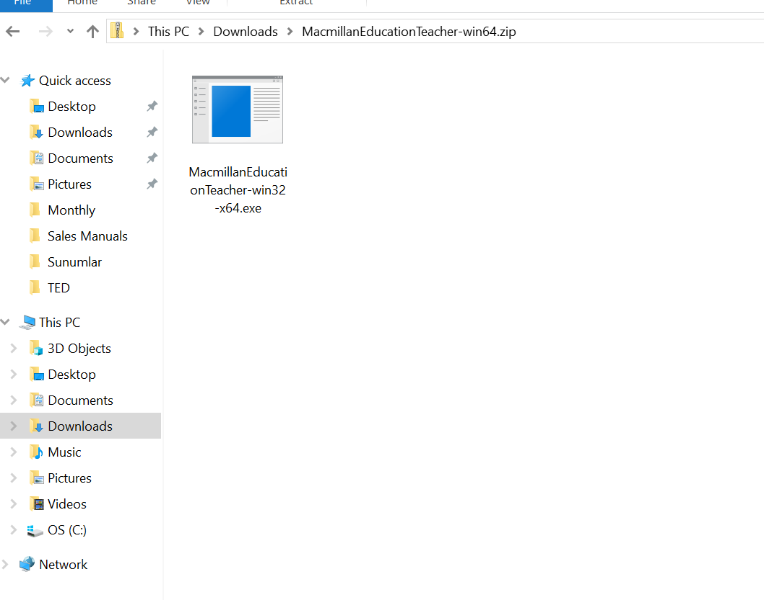
7. Click the Exe file in the downloads folder

Slide 13
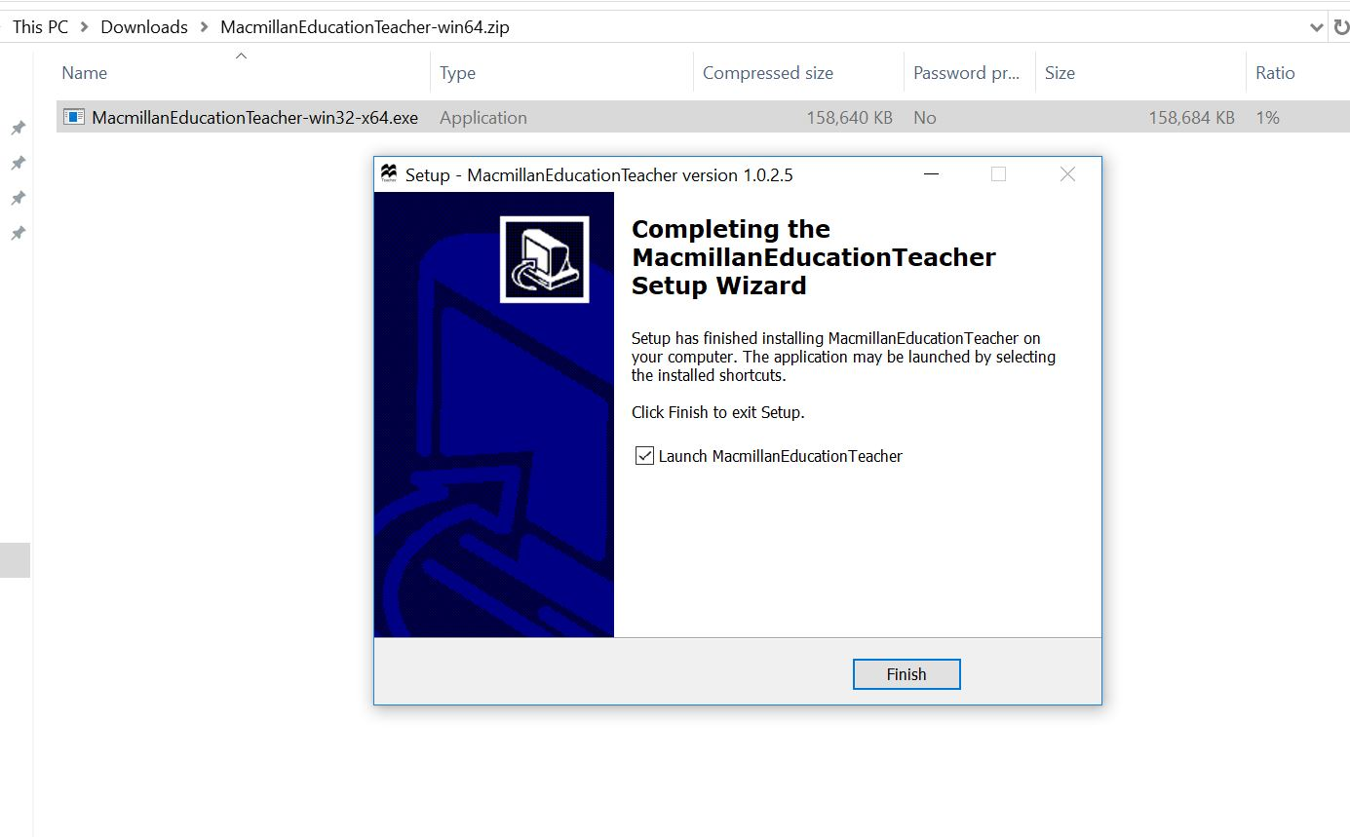
8. Click on Finish button when the installation is completed

Slide 14
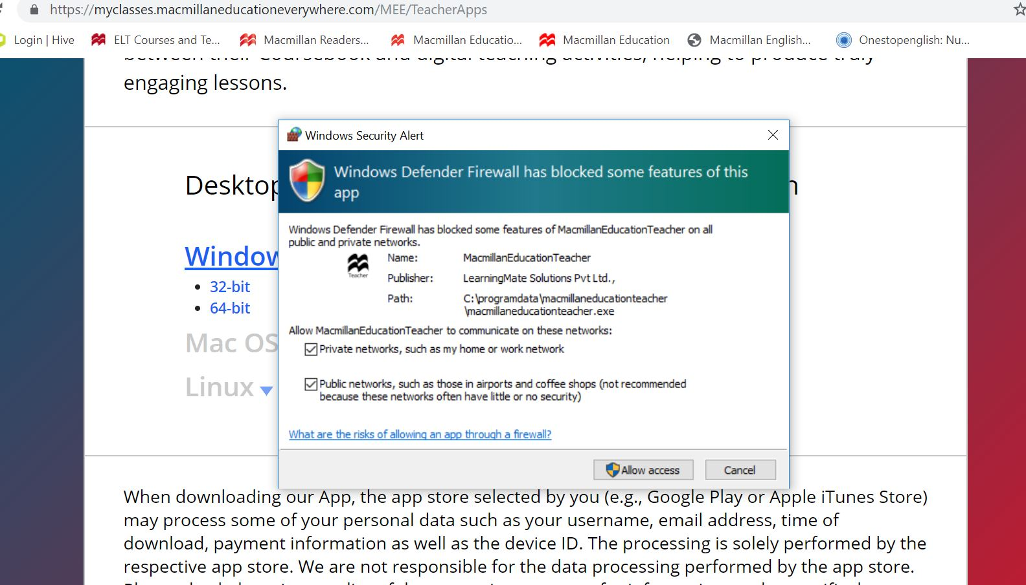
9. Allow Public Networks (airports&coffee shops) access

Slide 15
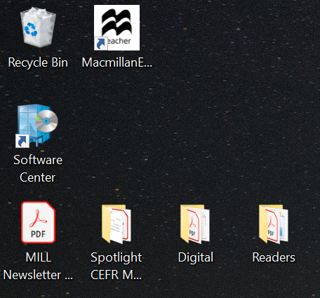
10. Go to your desktop and click on Macmillan Education shortcut

Slide 16
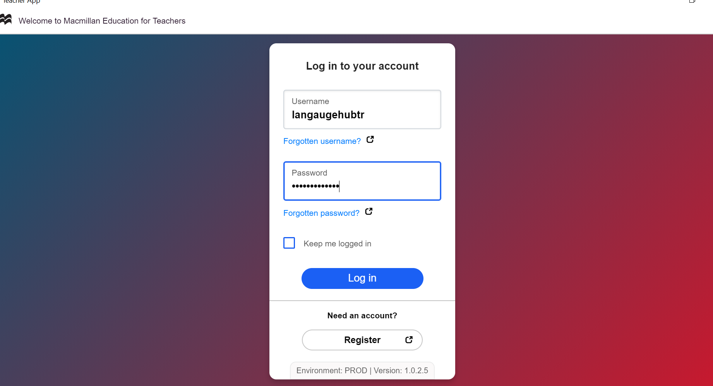
11. Enter your username and password

Slide 17
12. Select the relevant level

Slide 18
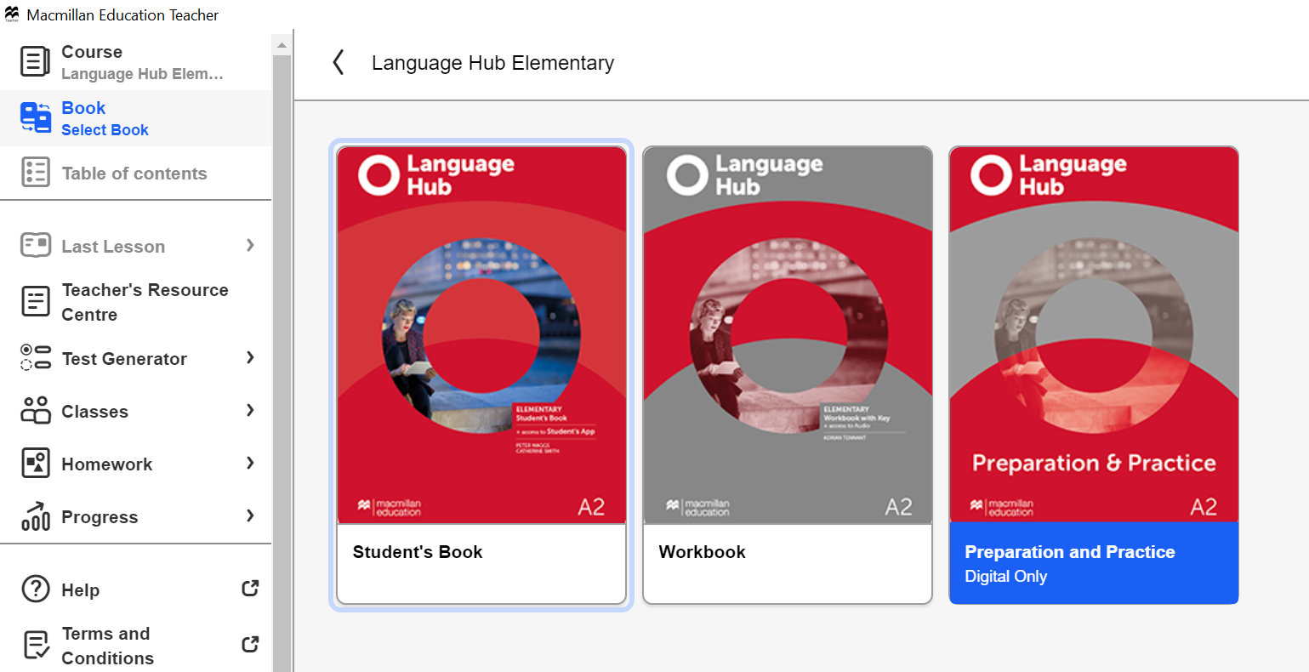
13. Click on the Student’s Book

Slide 19
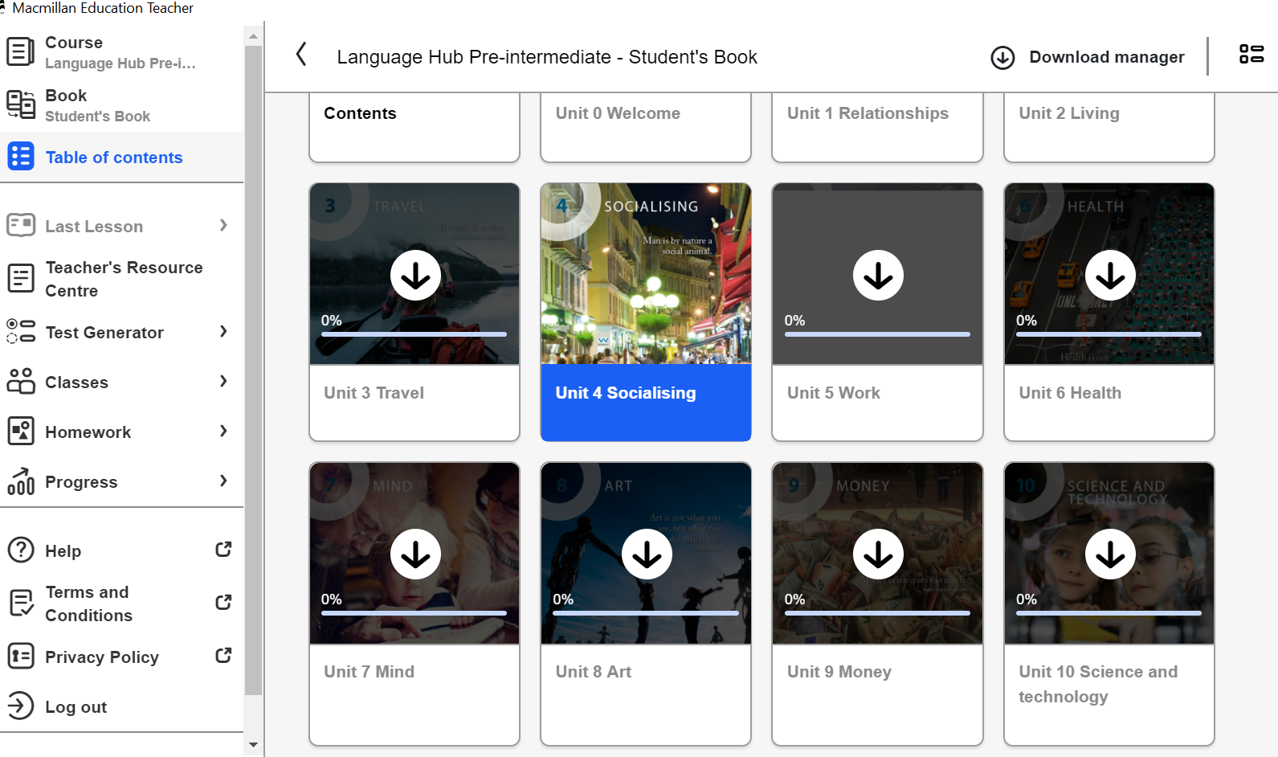
14. In order to see a unit click on the download button

Slide 20
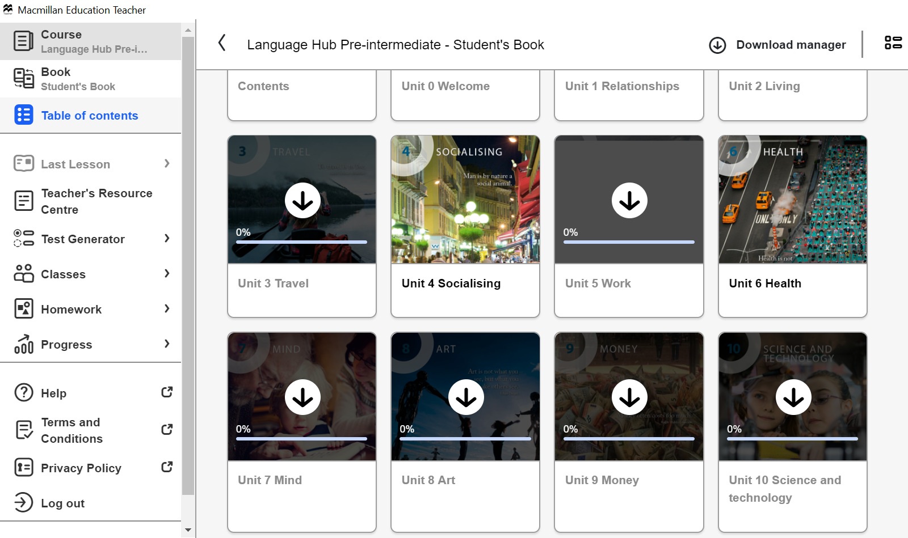
15. The unit can be accessed now.

Slide 21
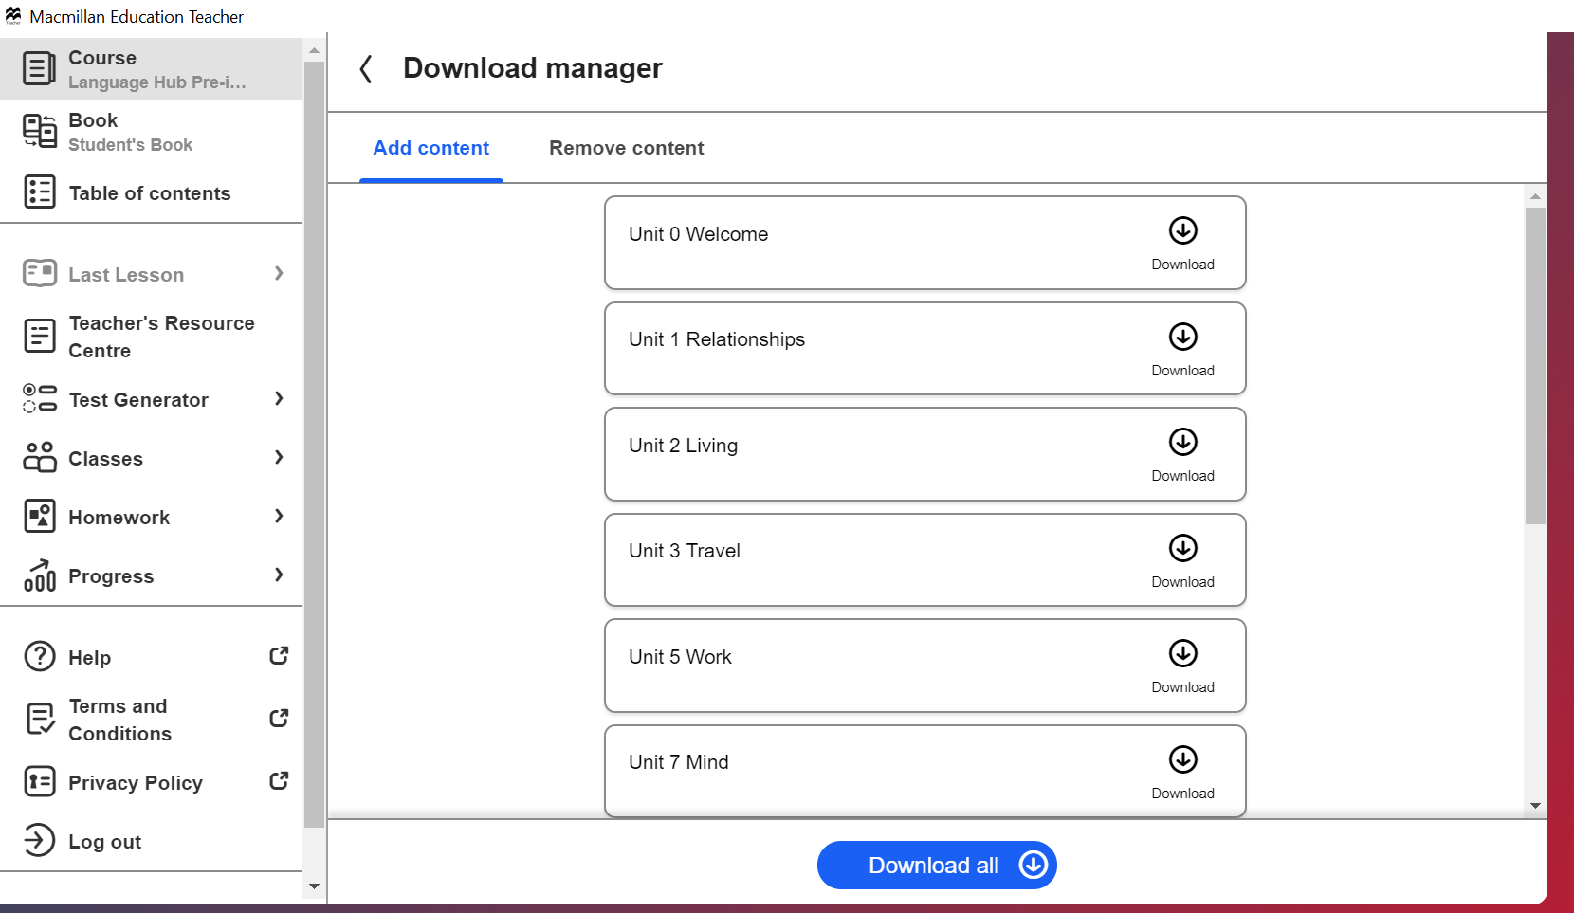
16. Alternatively, you can use the Download Manager

Slide 22
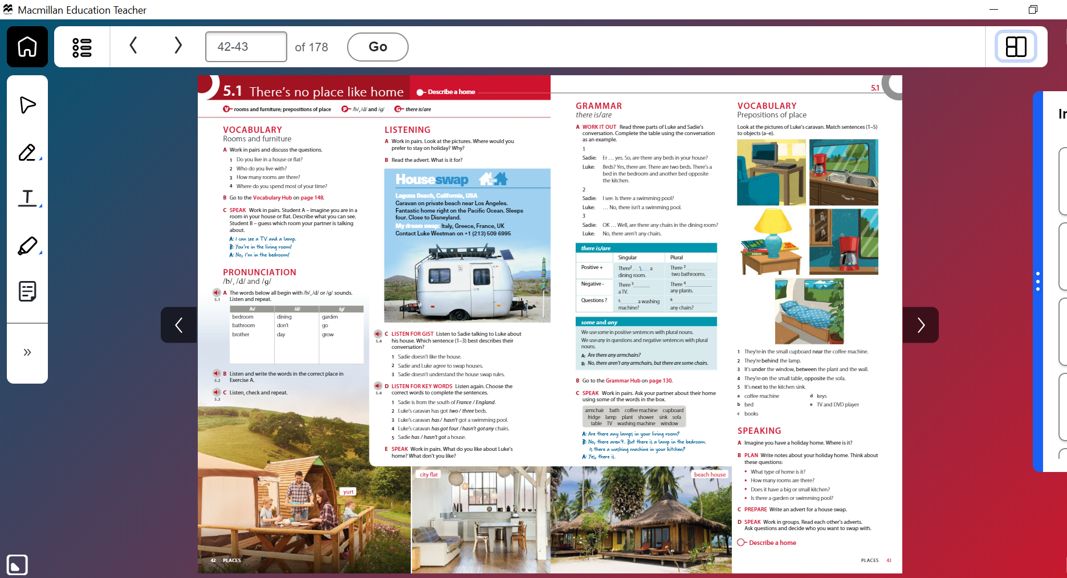
17. When you go the lesson click on hot spot button

Slide 23
18. You can zoom in and focus on the individual activity.

Slide 24
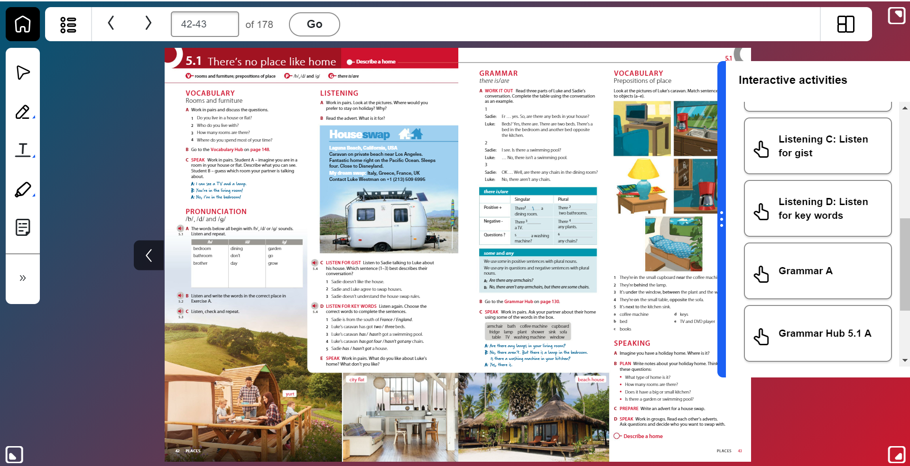
19. You can go down to the exercise level by clicking on the right hand side menu

Slide 25
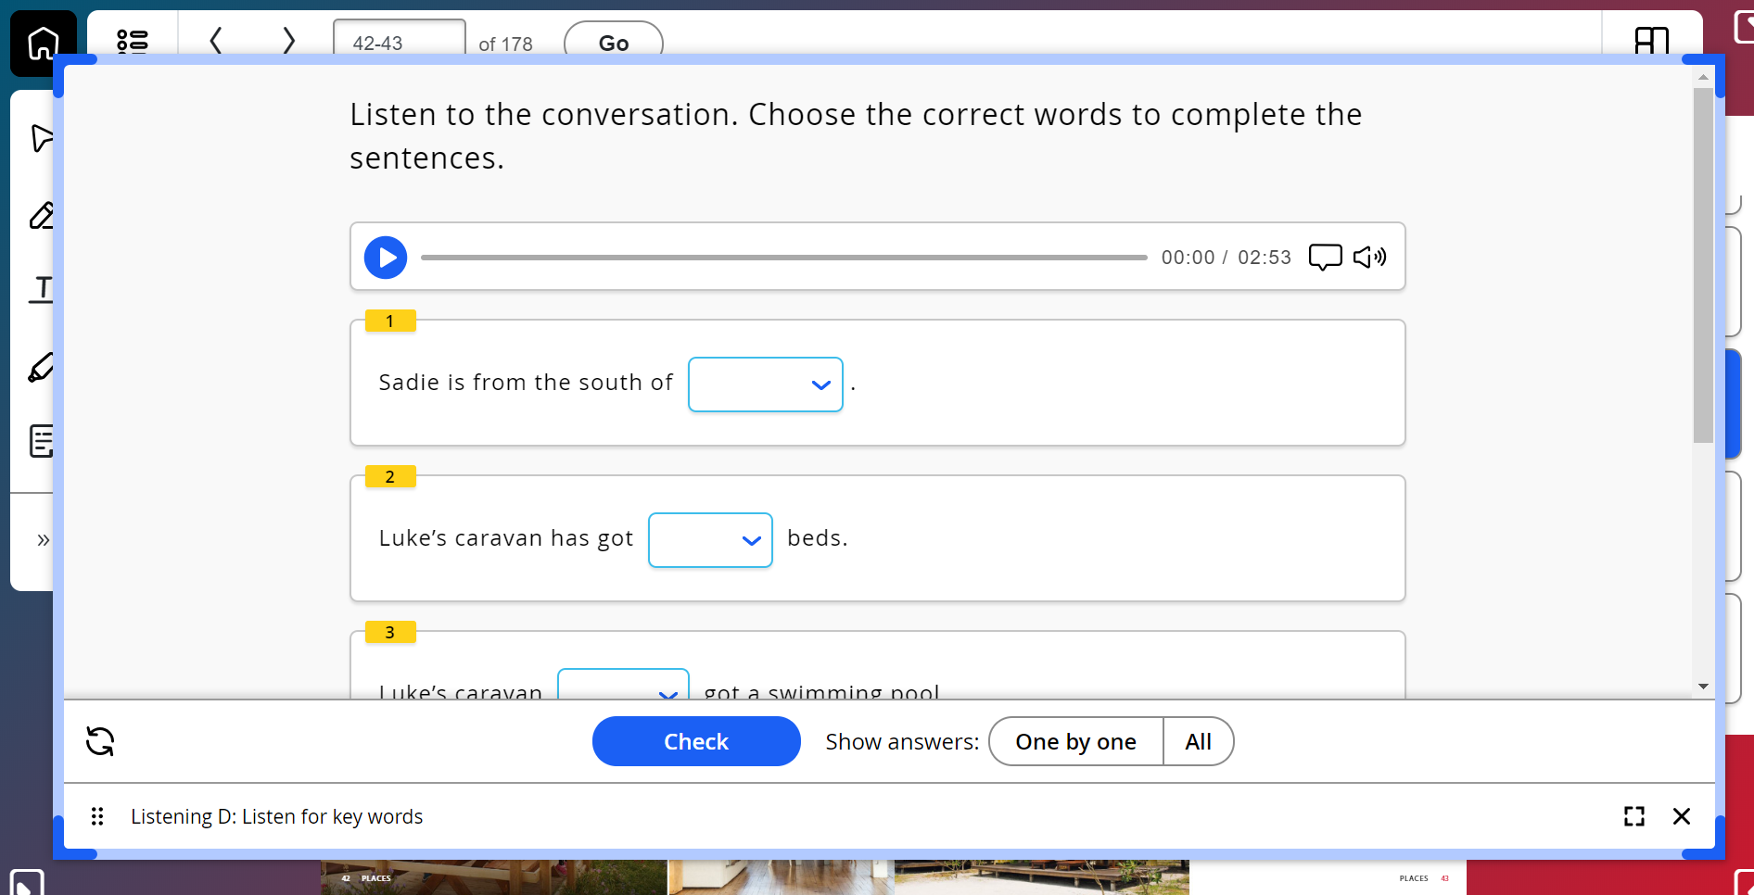
20. You can have your students listen, watch or do the exercise

Slide 26
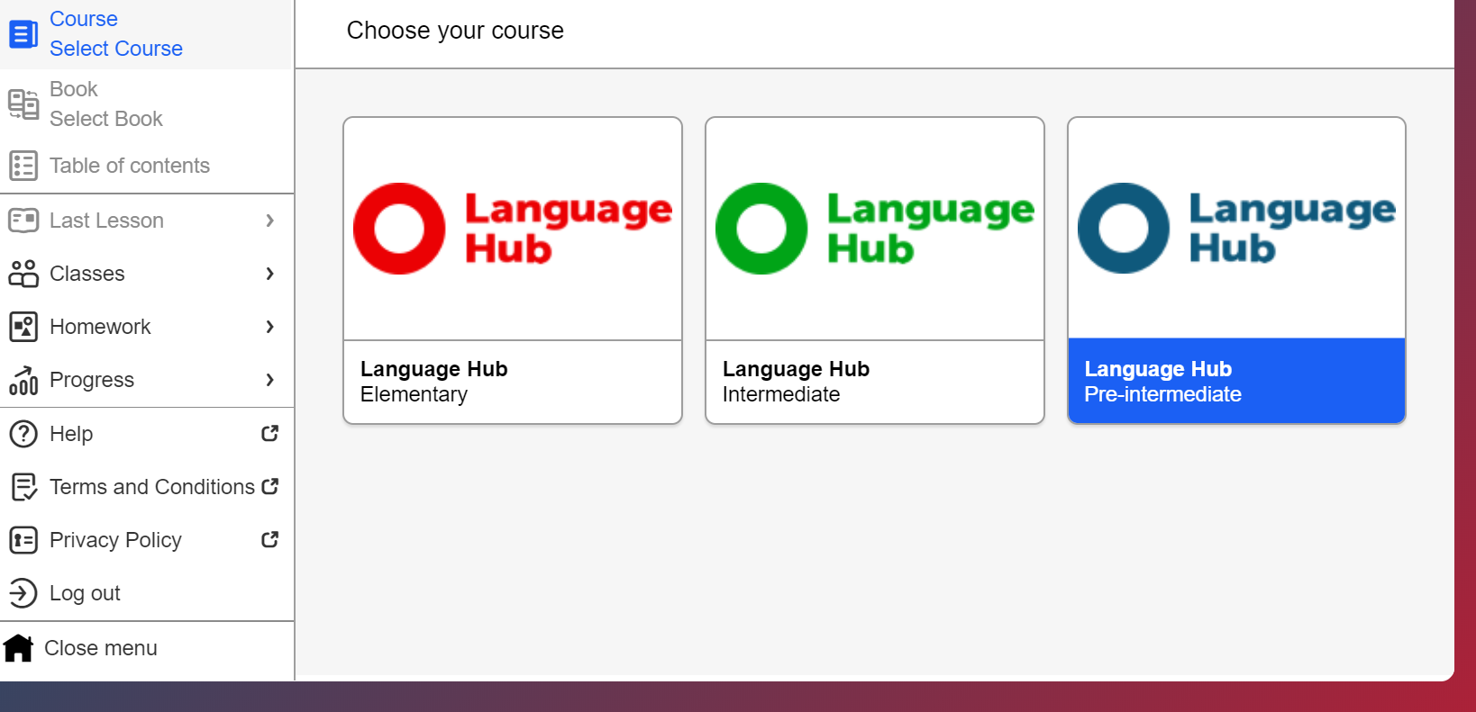
20. Creating an online class: go to classes tab

Slide 27
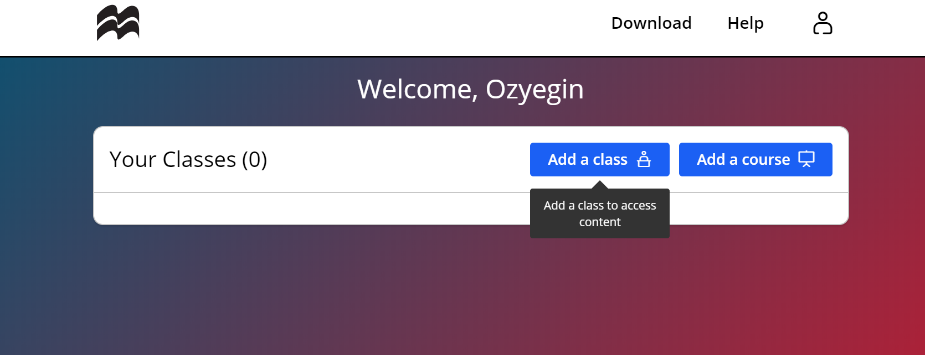
21. Click on add a class

Slide 28
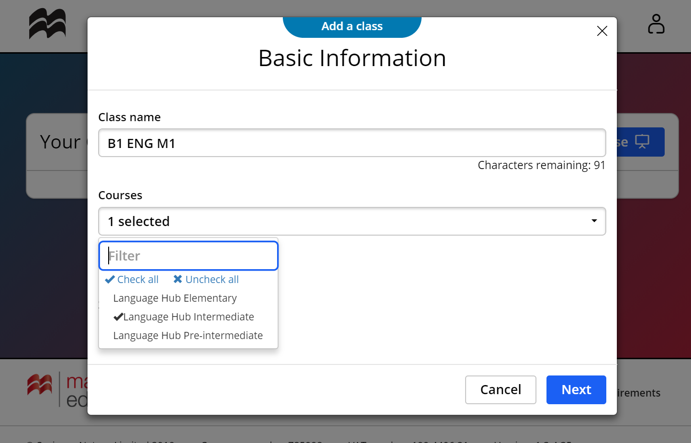
22. Enter class name and select the level

Slide 29
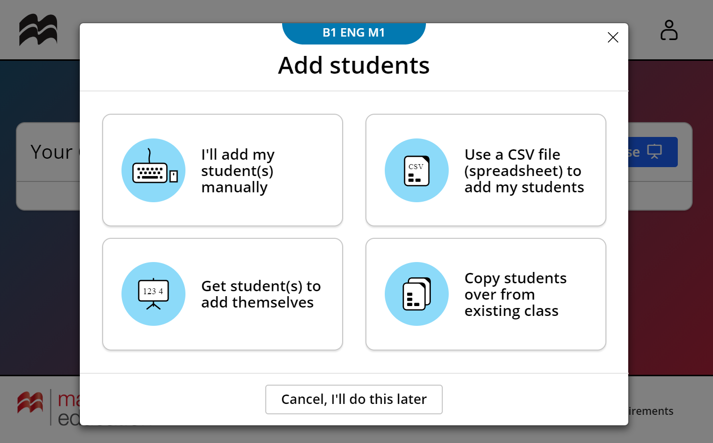
23. Click on get students to add themselves

Slide 30
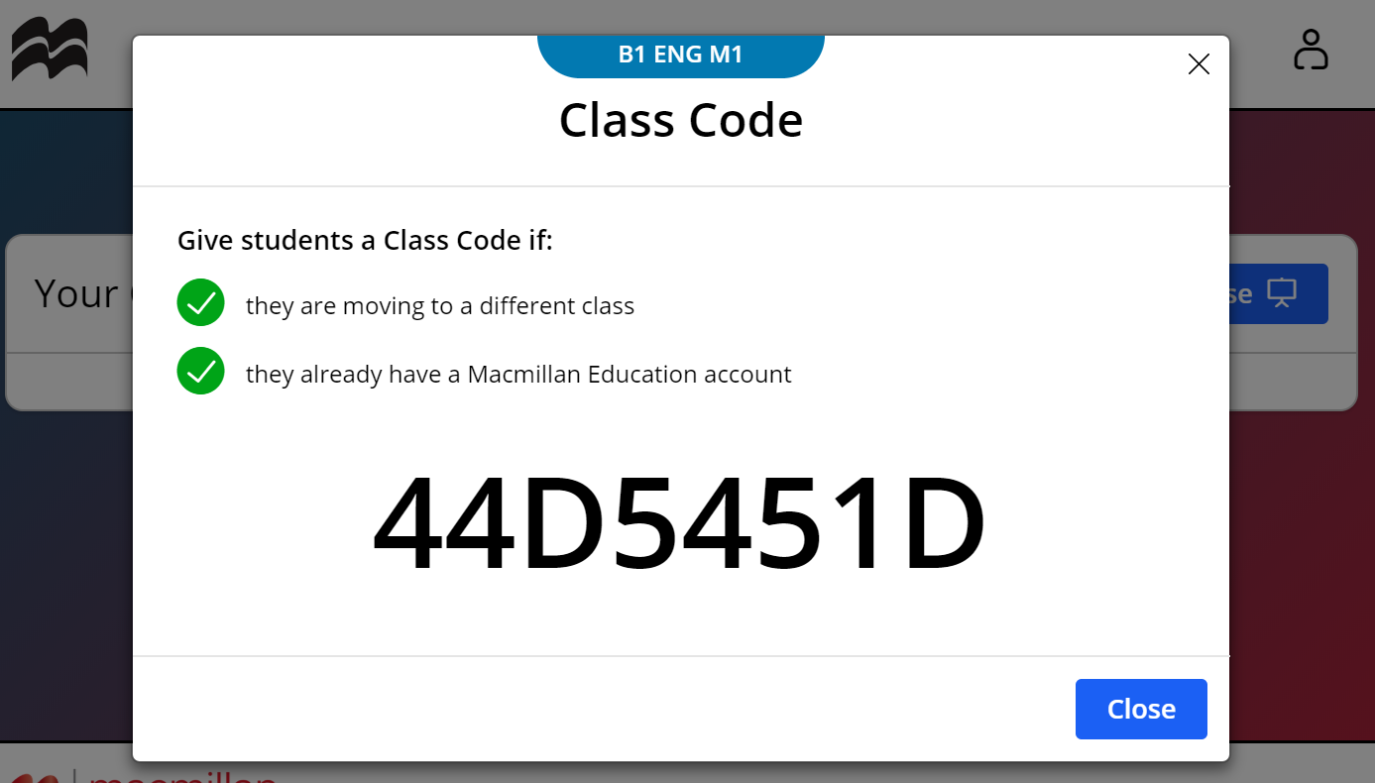
24. Note down the Class Code to be shared with the students

Slide 31
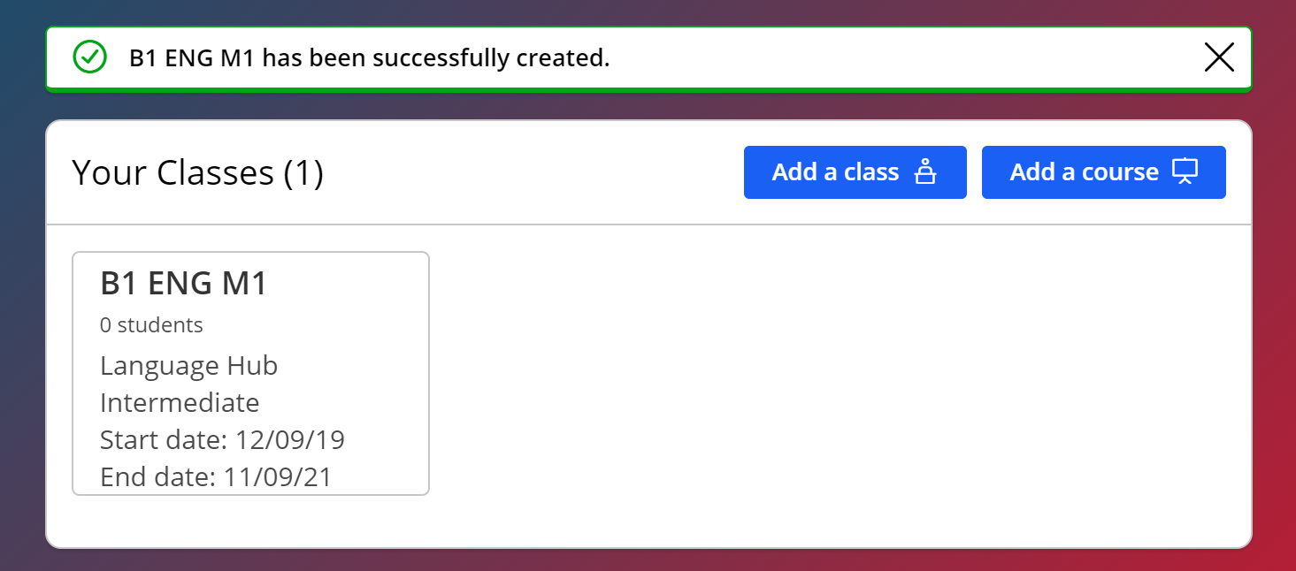
25. Your online course has been added successfully.

Slide 32
Please let us know if you need help, have further questions or a pressing issue.
https://macmillan.tawk.help/

